Slide 1
Chapter 11
Section 2 Intermolecular Forces
Objectives
Contrast ionic and molecular substances in terms of their physical characteristics and the types of forces that govern their behavior.
Describe dipole-dipole forces.
Explain how a hydrogen bond is different from other dipole-dipole forces and how it is responsible for many of water’s properties.

Slide 2
Chapter 11
Section 2 Intermolecular Forces
Objectives, continued
Describe London dispersion forces, and relate their strength to other types of attractions.

Slide 3
Chapter 11
Section 2 Intermolecular Forces
Comparing Ionic and Covalent Compounds
It takes energy to overcome the forces holding particles together.
Thus, it takes energy to cause a substance to go from the liquid to the gaseous state.
The boiling point of a substance is therefore a good measure of the strength of the forces that hold the particles together.
Melting point also relates to attractive forces between particles.

Slide 4
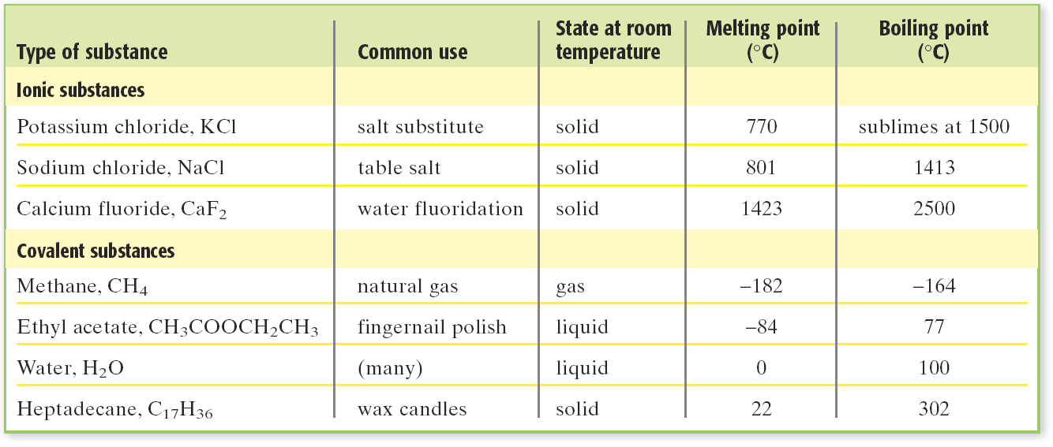
Chapter 11
Section 2 Intermolecular Forces
Comparing Ionic and Covalent Compounds, continued
Most covalent compounds melt at lower temperatures than ionic compounds do.

Slide 5
Chapter 11
Section 2 Intermolecular Forces
Comparing Ionic and Covalent Compounds, continued
Oppositely Charged Ions Attract Each Other
Ionic substances generally have much higher forces of attraction than covalent substances.
For small ions, attractions between ions of opposite charge hold the ions tightly in a crystal lattice.
These attractions are overcome only by heating to very high temperatures.

Slide 6
Chapter 11
Section 2 Intermolecular Forces
Comparing Ionic and Covalent Compounds, continued
Oppositely Charged Ions Attract Each Other, continued
If the ions are larger, then the distances between them are larger and the forces are weaker.
Thus, ionic compounds with small ions have high melting points.

Slide 7
Chapter 11
Section 2 Intermolecular Forces
Comparing Ionic and Covalent Compounds, continued
Intermolecular Forces Attract Molecules to Each Other
Intermolecular forces are the forces of attraction between molecules of covalent compounds.
Intermolecular forces include dipole-dipole forces and London dispersion forces.

Slide 8
Chapter 11
Section 2 Intermolecular Forces
Dipole-Dipole Forces
Dipole-Dipole Forces Affect Melting and Boiling Points
Dipole-dipole forces are interactions between polar molecules.
When molecules are very polar, the dipole-dipole forces are very significant.
The more polar the molecules are, the higher the boiling point of the substance.

Slide 9
Chapter 11
Section 2 Intermolecular Forces
Hydrogen Bonds
A hydrogen bond is a dipole-dipole force occurring when a hydrogen atom that is bonded to a highly electronegative atom of one molecule is attracted to two unshared electrons of another molecule.
In general, compounds with hydrogen bonding have higher boiling points than comparable compounds.

Slide 10
Chapter 11
Section 2 Intermolecular Forces
Hydrogen Bonds, continued
As the electronegativity difference of the hydrogen halides increases, the boiling point increases.
The boiling points increase somewhat from HCl to HBr to HI but increase a lot more for HF due to the hydrogen bonding between HF molecules.

Slide 11
Chapter 11
Section 2 Intermolecular Forces
Hydrogen Bonds, continued
Hydrogen Bonds Form with Electronegative Atoms
Strong hydrogen bonds can form with a hydrogen atom that is covalently bonded to very electronegative atoms in the upper-right part of the periodic table: nitrogen, oxygen, and fluorine.
Hydrogen Bonds Are Strong Dipole-Dipole Forces
The combination of the large electronegativity difference (high polarity) and hydrogen’s small size accounts for the strength of the hydrogen bond.

Slide 12
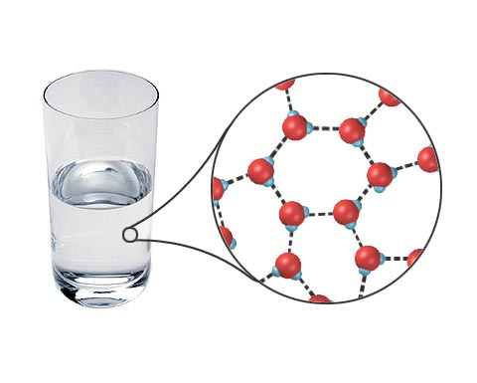
Hydrogen Bonding
Chapter 11
Section 2 Intermolecular Forces

Slide 13
Chapter 11
Section 2 Intermolecular Forces
Hydrogen Bonds, continued
Hydrogen Bonding Explains Water’s Unique Properties
Each water molecule forms multiple hydrogen bonds, so the intermolecular forces in water are strong.
The angle between the two H atoms is 104.5°.
When water forms ice, the ice crystals have large amounts of open space. Thus, ice has a low density.
Water is unusual in that its liquid form is denser than its solid form.

Slide 14
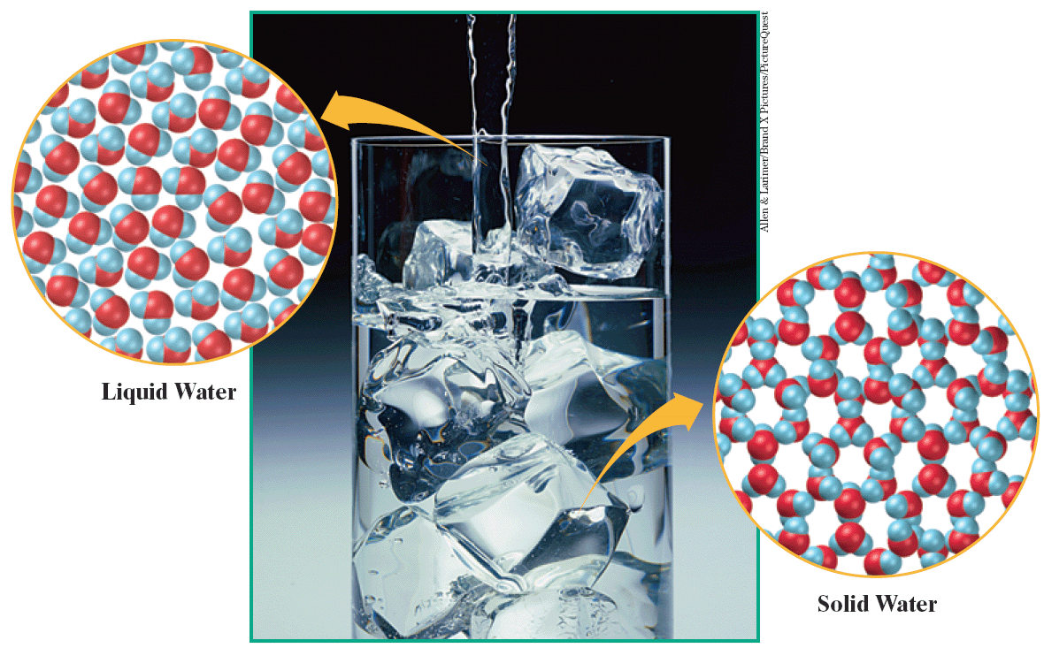
Chapter 11
Section 2 Intermolecular Forces
Ice and Water

Slide 15
Chapter 11
Section 2 Intermolecular Forces
London Dispersion Forces
A substance with weak attractive forces will be a gas because there is not enough attractive force to hold molecules together as a liquid or a solid.
However, many nonpolar substances are liquids.
What forces of attraction hold together nonpolar molecules and atoms?
London dispersion forces are the dipole-dipole force resulting from the uneven distribution of electrons and the creation of temporary dipoles.

Slide 16
Chapter 11
Section 2 Intermolecular Forces
London Dispersion Forces, continued
London Dispersion Forces Exist Between Nonpolar Molecules
As molar mass increases, so does the number of electrons in a molecule.
London dispersion forces are roughly proportional to the number of electrons present.
Thus, the strength of London dispersion forces between nonpolar particles increases as the molar mass of the particles increases.

Slide 17
Chapter 11
Section 2 Intermolecular Forces
London Dispersion Forces, continued
London Dispersion Forces Result from Temporary Dipoles
The electrons in atoms can move about in orbitals and from one side of an atom to the other.
When the electrons move toward one side of an atom or molecule, that side becomes momentarily negative and the other side becomes momentarily positive.
When the positive side of a momentarily charged molecule moves near another molecule, it can attract the electrons in the other molecule.

Slide 18
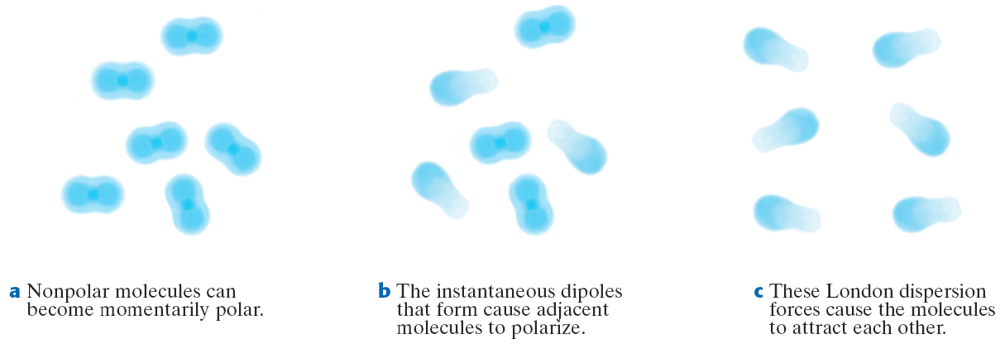
Chapter 11
Section 2 Intermolecular Forces
Temporary Dipoles

Slide 19
Chapter 11
Section 2 Intermolecular Forces
London Dispersion Forces, continued
Properties Depend on Types of Intermolecular Force
The differences in the properties of the substances are related to the differences in the types of forces that act within each substance.
Nonpolar molecules can experience only London dispersion forces.
Polar molecules experience both dipole-dipole forces and London dispersion forces.

Slide 20
Chapter 11
Section 2 Intermolecular Forces
London Dispersion Forces, continued
Properties Depend on Types of Intermolecular Force, continued
Forces between ions are generally much stronger than the forces between molecules, so the melting points of ionic substances tend to be higher.
Each ion in NaCl is strongly attracted to six oppositely charged ions. NaCl has a melting point of 801°C.
Iodine particles are neutral molecules that are not as strongly attracted to each other. I₂ has a melting point of 114°C.

Slide 21
Chapter 11
Section 2 Intermolecular Forces
London Dispersion Forces, continued
Particle Size and Shape Also Play a Role
Dipole-dipole forces are generally stronger than London dispersion forces.
However, both of these forces between molecules are usually much weaker than ionic forces in crystals.
When the forces between ions are spread out over large distances, as with large ions or oddly shaped ions that do not fit close together, they do not have as great of an effect.

