Slide 1
3.3 A

Slide 2
Chapter 3
Section 3 Electron Configuration
Nuclear Model of Atom
Experiments of Rutherford led to the replacement of the plum pudding model of the atom with a nuclear model of the atom.
Rutherford suggested that electrons, like planets orbiting the sun, revolve around the nucleus in circular or elliptical orbits.
Rutherford’s model could not explain why electrons did not crash into the nucleus.
The Rutherford model of the atom was replaced by a model developed by Niels Bohr.

Slide 3
Chapter 3
Section 3 Electron Configuration
Bohr’s Model
Bohr’s model
electrons can be only certain distances from the nucleus
Each distance corresponds to a certain quantity of energy that an electron can have.
An electron that is as close to the nucleus as it can be is in its lowest energy level.
The farther an electron is from the nucleus, the higher the energy level that the electron occupies.
The difference in energy between two energy levels is known as a quantum of energy.

Slide 4
Chapter 3
Section 3 Electron Configuration
Atomic Models, continued
Bohr’s Model Confines Electrons to Energy Levels
Rutherford’s model of an atom
electrons orbit the nucleus just as planets orbit the sun
Bohr’s model of an atom
electrons travel around the nucleus in specific energy levels

Slide 5
Chapter 3
Section 3 Electron Configuration
Electrons Act Like Both Particles and Waves
Thomson’s experiments demonstrated that electrons act like particles that have mass.
Broglie pointed stated that the behavior of electrons according to Bohr’s model was similar to the behavior of waves.
De Broglie suggested that electrons could be considered waves confined to the space around a nucleus.
As waves, electrons could have only certain frequencies which correspond to the specific energy levels.

Slide 6
Chapter 3
Section 3 Electron Configuration
Present Day Model of Atom
The present-day model of the atom takes into account both the particle and wave properties of electrons.
Electrons are located in orbitals
regions around a nucleus that correspond to specific energy levels.
Orbitals are regions where electrons are likely to be found.
Orbitals are sometimes called electron clouds because they do not have sharp boundaries. Because electrons can be in other places, the orbital has a fuzzy boundary like a cloud.

Slide 7
Chapter 3
Section 3 Electron Configuration
Atomic Models, continued
Electrons Act Like Both Particles and Waves, continued
According to the current model of an atom, electrons are found in orbitals.

Slide 8
Chapter 3
Section 3 Electron Configuration
Electrons and Light
Light could be thought of as moving waves that have given frequencies, speeds, and wavelengths.
In empty space, light waves travel at 2.998 × 10⁸ m/s.
The wavelength is the distance between two consecutive peaks or troughs of a wave.
The distance of a wavelength is usually measured in meters.

Slide 9
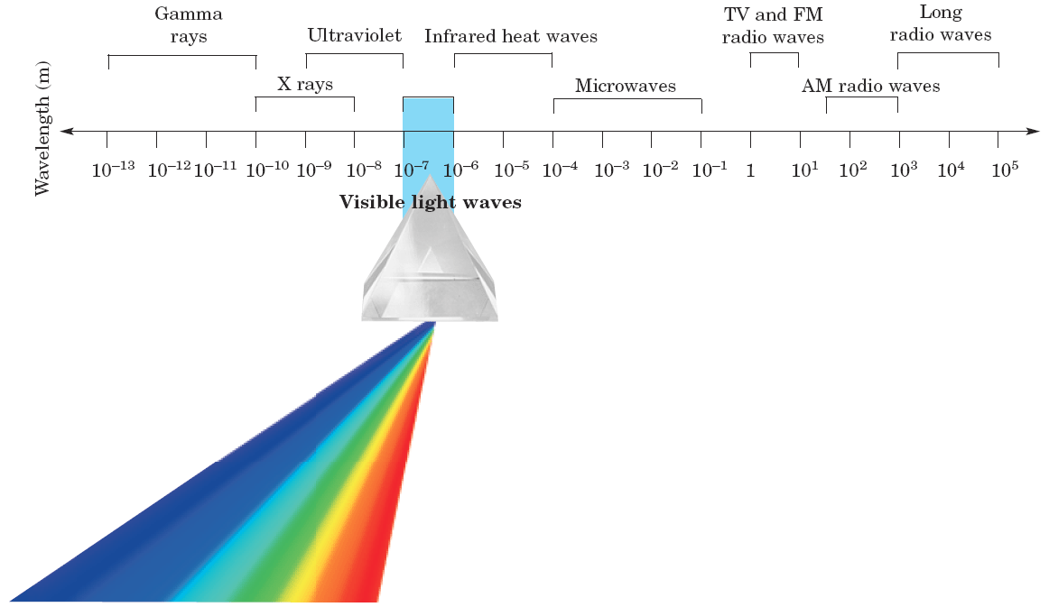
Chapter 3
Section 3 Electron Configuration
Electromagnetic Spectrum

Slide 10
Chapter 3
Section 3 Electron Configuration
Electromagnetic spectrum
The electromagnetic spectrum is all of the frequencies or wavelengths of electromagnetic radiation.
The wavelength of light can vary from 10⁵ m to less than 10^{–13} m.
In 1905, Albert Einstein proposed that light also has some properties of particles.
His theory would explain a phenomenon known as the photoelectric effect.
This effect happens when light strikes a metal and electrons are released.

Slide 11
Chapter 3
Section 3 Electron Configuration
Einstein and Light
Einstein proposed that light has the properties of both waves and particles.
Light can be described as a stream of particles, the energy of which is determined by the light’s frequency.
Light is an electromagnetic wave.
Red light has a low frequency and a long wavelength.
Violet light has a high frequency and a short wavelength.
The frequency and wavelength of a wave are inversely related.

Slide 12
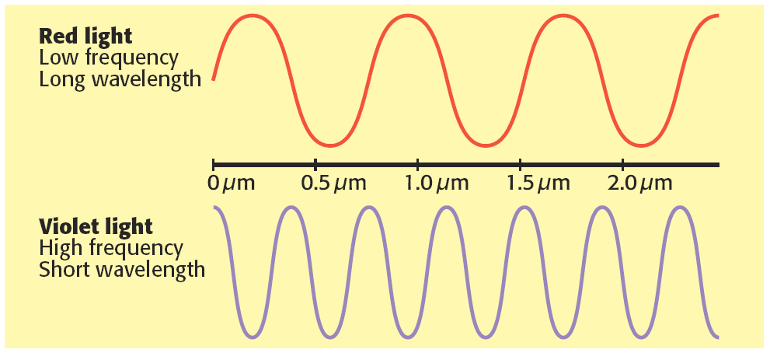
Chapter 3
Section 3 Electron Configuration
Electrons and Light, continued
Light is an electromagnetic Wave, continued
The frequency and wavelength of a wave are inversely related.
As frequency increases, wavelength decreases.

Slide 13
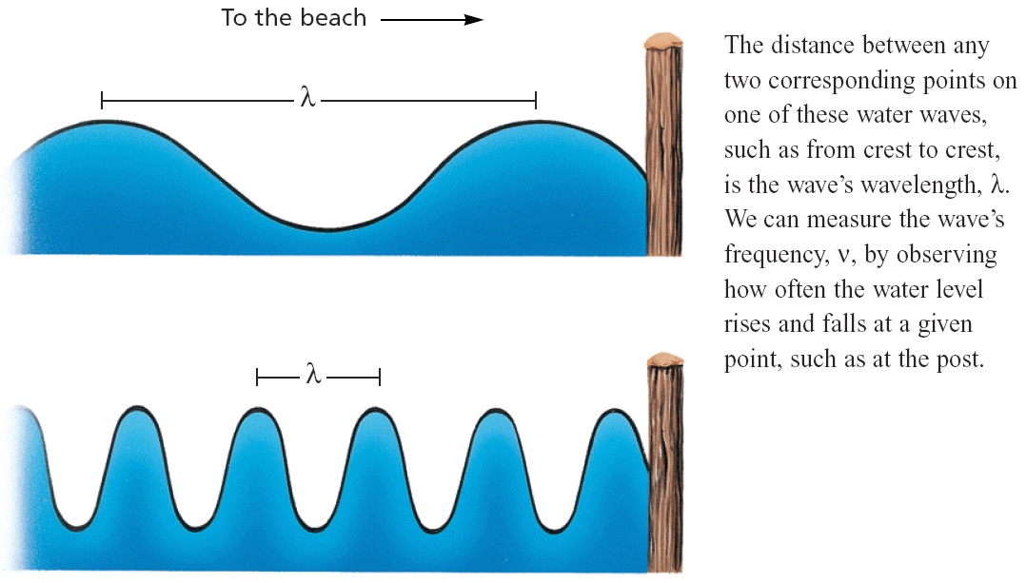
Chapter 3
Section 3 Electron Configuration
Wavelength and Frequency

Slide 14
Chapter 3
Section 3 Electron Configuration
Light Emission
When a high-voltage current is passed through a tube of hydrogen gas at low pressure, lavender-colored light is seen. When this light passes through a prism, you can see that the light is made of only a few colors. This spectrum of a few colors is called a line-emission spectrum.
Experiments with other gaseous elements show that each element has a line-emission spectrum that is made of a different pattern of colors.

Slide 15
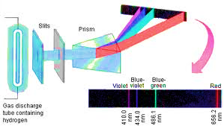

Slide 16
Chapter 3
Section 3 Electron Configuration
Hydrogen Line-emission Spectrum
In 1913, Bohr showed that hydrogen’s line-emission spectrum could be explained by assuming that the hydrogen atom’s electron can be in any one of a number of distinct energy levels.
An electron can move from a low energy level to a high energy level by absorbing energy.
Electrons at a higher energy level are unstable and can move to a lower energy level by releasing energy. This energy is released as light that has a specific wavelength.
Each different move from a particular energy level to a lower energy level will release light of a different wavelength.

Slide 17
Chapter 3
Section 3 Electron Configuration
Electrons Movement
An electron in a state of its lowest possible energy, is in a ground state.
The ground state is the lowest energy state of a quantized system
If an electron gains energy, it moves to an excited state.
An excited state is a state in which an atom has more energy than it does at its ground state
An electron in an excited state will release a specific quantity of energy as it quickly “falls” back to its ground state.

Slide 18
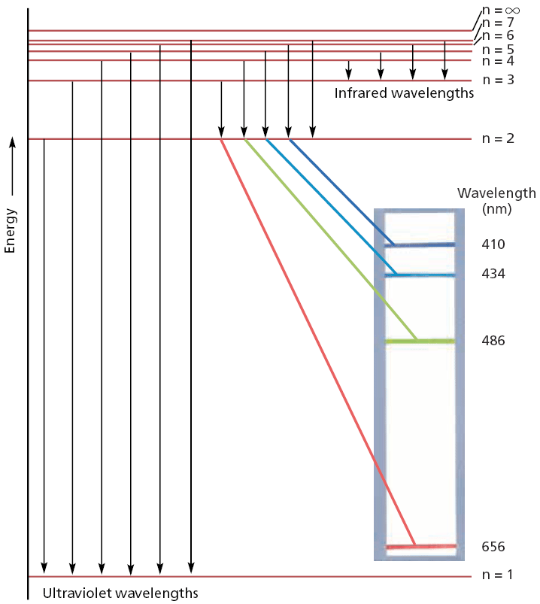
Chapter 3
Section 3 Electron Configuration
Electrons and Light, continued
Light Provides Information About Electrons, continued
An electron in a hydrogen atom can move between only certain energy states, shown as n = 1 to n = 7.
In dropping from a higher energy state to a lower energy state, an electron emits a characteristic wavelength of light.

Slide 19
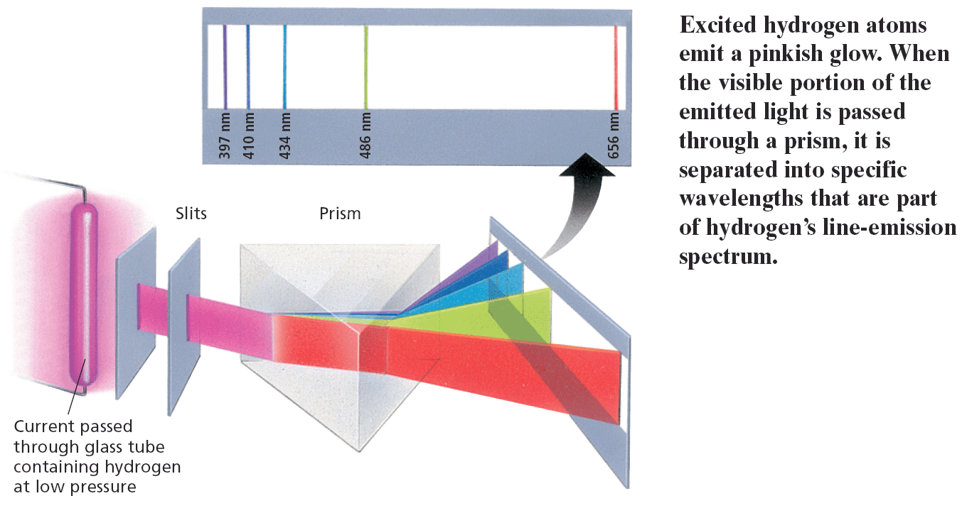
Chapter 3
Section 3 Electron Configuration
Hydrogen’s Line-Emission Spectrum

