Slide 1
Review of the Scientific Method

Slide 2
Scientific Method:
Outlines a series of steps for answering questions.
Obtains “evidence” through the use of experiments.

Slide 3
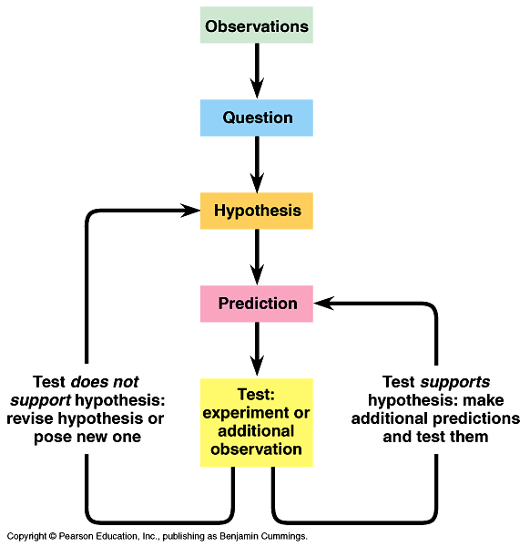

Slide 4
Scientific Method Steps
1. Identify the purpose/question
2. What is already known? Knowledge Probe
3. Formulate a hypothesis.
4. Conduct an experiment changing one variable at a time. All other factors are held constant. (Why?)
5. Data Analysis. Have replicates (Why?)
6.Explanation.- Claim, evidence, and reasoning
-Does the data support the claim?
7. Evaluation- How can I make this lab investigation better? What went wrong

Slide 5
Purpose/Question
Based on observations- Use your senses to obtain the observations
The question that you want to answer by conduction the lab investigation
The question should be: important, ethical, reasonable, interesting

Slide 6
Primary Knowledge probe
Background information that you already know before conduction the lab investigation

Slide 7
Hypothesis/Prediction
Can be tested through the lab investigation
Prediction of what will happen during the lab
Based on primary knowledge probe
State the dependent and independent variables
Identify what conditions are held constant
Write hypothesis as an if… then statement

Slide 8
Conduct the lab investigation
A planned procedure to test your hypothesis
Several steps or a few
Make observations
Collect data
Hold all variables constant except the one that you are changing in the investigation
-Independent variable
-The factor that is being changed in the experiment
Dependent variable
-Variable that is measured
-Outcome of the independent variable

Slide 9
Controlled experiment
Group that is experimented on is compared to one that is not
Control group
-The group in the experiment that is not experimented on
-Identical to the experimental group except for one factor (the one that is being tested)

Slide 10
Data analysis
Determine what data you will collect
Make a table to record you data in
Collect data through observations that you make during the lab investigation
Perform calculations and statistics
Decide how to graphically show your data

Slide 11
Explanation
Scientific explanation= Claim + Evidence + Reasoning
Claim- Answers the problem/question that you are investigating
Does your data support your hypothesis?
1-2 sentences
Evidence- Comes from your observations (data collection)
How does the data you gathered during the lab investigation support your claim?
Use at least 3 pieces of data to support your claim
1 paragraph
Reasoning- Explain how your evidence supports your claim
Use your understanding of Biology concepts (previous knowledge, knowledge probe, etc.) to explain why results did or did not support the hypothesis
Think about your evidence (data) and explain how it supports your claim
1 paragraph

Slide 12
Evaluation
How do your results compare to others?
1-2 sentences comparing your finding to others in your class
What could have gone wrong?
1 paragraph
Discuss any problems or difficulties that you had with the investigation that may have impacted your results
How can you improve this lab investigation if you were to perform it again?
1 paragraph
Give suggestions for improving the lab
What application could this lab have?
1-2 sentences
Describe how this applies to science or society
How is this information beneficial?

Slide 13
Comment
Nothing is ever proven in science
Can only be disproven
Experiments either support or fail to support a particular hypothesis
Disproving a hypothesis is as important as supporting it

Slide 14
“theory” vs Theory
Everyday use of word is not scientific
Implies “untested speculation”

Slide 15
Theory
Broader in scope than hypothesis.
Not determined by single experiment, but have been supported by many experiments by many scientists.

Slide 16
Theory
Comprehensive explanation supported by abundance of evidence
Theories allow predictions

Slide 17
Examples of Theories
Atomic Theory
Gravitational Theory
Theory of Relativity
Cell Theory

Slide 18
Lab reports
Please refer to the BLABN setup, maintenance, and lab reports sheets that are in the reference section of your BLABN

