Slide 1
Chapter 1
Section 2 Describing Matter
Matter Has Mass and Volume
Matter is anything that has mass and volume.
Volume is the space an object occupies.
Mass is the quantity of matter in an object.
Devices used for measuring mass in a laboratory are called balances.
Weight is the force produced by gravity acting on a mass.

Slide 2
Chapter 1
Section 2 Describing Matter
Units of Measurement
When working with numbers, be careful to distinguish between a quantity and its unit.
Quantity describes something that has magnitude, size, or amount.
Unit is a quantity adopted as a standard of measurement.

Slide 3
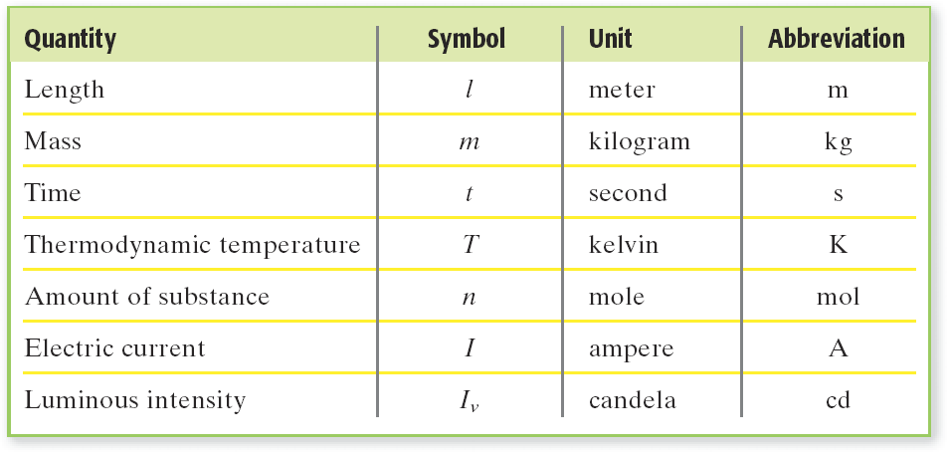
Chapter 1
Section 2 Describing Matter
Units of Measurement, continued
Scientist Express Measurements in SI Units
Scientists worldwide use a set of units called the Système Internationale d’Unités or SI.

Slide 4
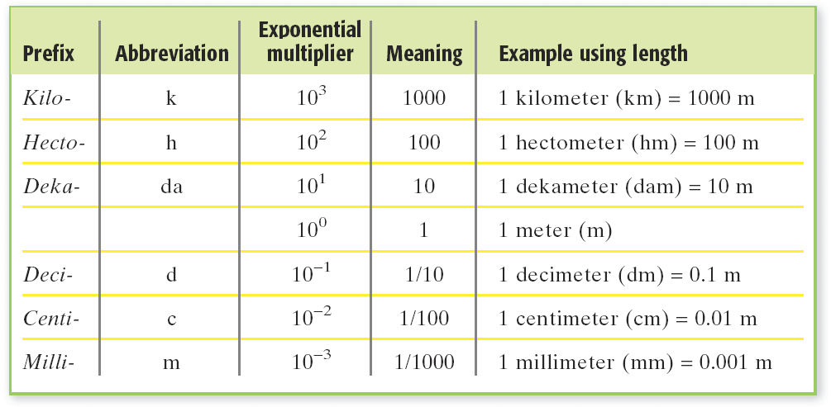
Chapter 1
Section 2 Describing Matter
Units of Measurement, continued
Scientist Express Measurements in SI Units, continued
Base units can be too large or too small for some measurements, so the base units may be modified by attaching prefixes.

Slide 5
SI (Système Internationale d’Unités )
Chapter 1
Visual Concepts

Slide 6
Chapter 1
Section 2 Describing Matter
Unit of Measurement, continued
Converting One Unit to Another
A conversion factor is a simple ratio that relates two units that express a measurement of the same quantity.
example: You can construct conversion factors between kilograms and grams as follows:

Slide 7
Chapter 1
Section 2 Describing Matter
Using Conversion Factors

Slide 8
Chapter 1
Section 2 Describing Matter
Converting Units
Sample Problem A
Convert 0.851 L to milliliters.

Slide 9
Chapter 1
Section 2 Describing Matter
Sample Problem A Solution
The equality that links the two units is 1000 mL = 1 L. (The prefix milli- represents 1/1000 of a base unit.)
The conversion factor needed must cancel liters and leave milliliters. Thus, liters must be on the bottom of the fraction and milliliters must be on the top.

Slide 10
Chapter 1
Section 2 Describing Matter
Derived Units
Many quantities you can measure need units other than the seven basic SI units.
These units are derived by multiplying or dividing the base units.
Speed is distance divided by time.The derived unit of speed is meters per second (m/s).
A rectangle’s area is found by multiplying its length (in meters) by its width (also in meters).
Its unit is square meters (m²).

Slide 11
Chapter 1
Section 2 Describing Matter
Derived Units, continued
Volume is another commonly used derived unit.
The volume of a book can be found by multiplying its length, width, and height.
The unit of volume is the cubic meter (m³).
This unit is too large and inconvenient in most labs. Chemists usually use the liter (L).
1L = 1000 mL = 1000 cm³

Slide 12
Chapter 1
Section 2 Describing Matter
Properties of Matter
Physical Properties
A physical property of a substance is a characteristic that does not involve a chemical change.
Physical properties of a substance can be determined without changing the nature of a substance.
Physical properties include texture, state, melting point, and boiling point.

Slide 13
Chapter 1
Section 2 Describing Matter
Properties of Matter, continued
Density is the Ratio of Mass to Volume
The density of an object is the mass of the object divided by volume of the object.
Densities are expressed in derived units such as g/cm³ or g/mL.
Density is calculated as follows:

Slide 14
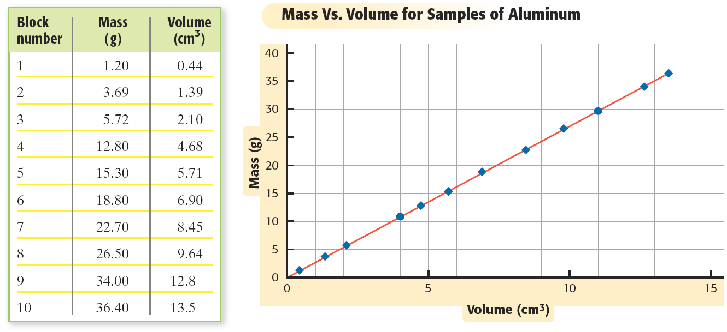
Chapter 1
Section 2 Describing Matter
Properties of Matter, continued
Density of an Object
The density of a substance is the same no mater what the size of the sample is.

Slide 15
Equation for Density
Chapter 1
Visual Concepts

Slide 16
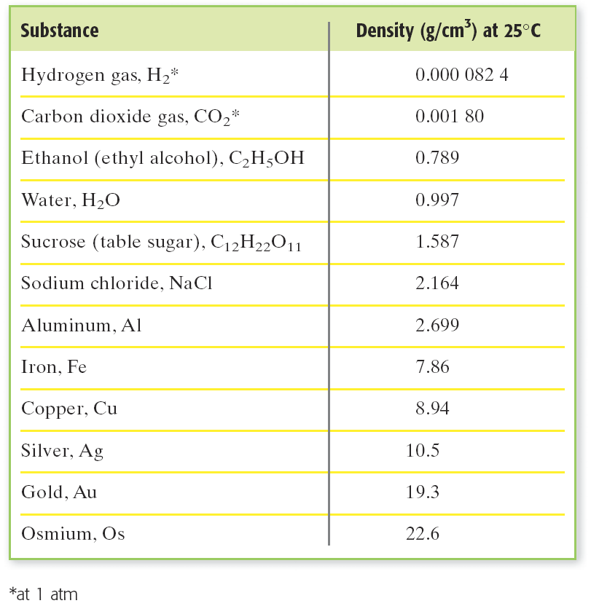
Chapter 1
Section 2 Describing Matter
Properties of Matter, continued
Density Can Be Used to Identify Substances
Because the density of a substance is the same for all samples, you can use this property to help identify substances.

Slide 17
Chapter 1
Section 2 Describing Matter
Properties of Matter, continued
Chemical Properties
A chemical property a property of matter that describes a substance’s ability to participate in chemical reactions.
A chemical property of many substances is that they react with oxygen.
example: rusting
Some substances break down into new substances when heated.

Slide 18
Signs of a Chemical Reaction
Chapter 1
Visual Concepts

