Slide 1
Rockford
Professional Learning
Gradual Release - Collaboration
September 23, 2014
7:30 to 9:10 am
8:15 to 9:55 am
Notes:
7:30
8:15

Slide 2
Mix Pair Freeze
A significant body of evidence suggests that regardless of the subject matter or content area, students learn more and retain information longer when they work in small groups - Dean et al.., 2012
Notes:
7:35
8:20
2 MIN A Mix Pair Freeze is considered a basic collaborative practice. It teaches listening and communication skills and can center on values, beliefs of both parties involved.

Slide 3
Pair Square
Students who work in collaborative groups appear more satisfied with their classes, complete more assignments, and generally like school better - Summers 2006
Notes:
7:37
8:22
2 MIN Pair square increases the group size and increases the communication skill mastery

Slide 4
Stir the Classroom
Students will be expected to collaborate in teams, express their ideas, and listen to one another as they communicate with purpose. They will be required to think critically together and express their thoughts in coherent ways for a variety of different applications. Common Core
Notes:
7:39 - 7:47
8:24-8:32
2 minutes

Slide 5
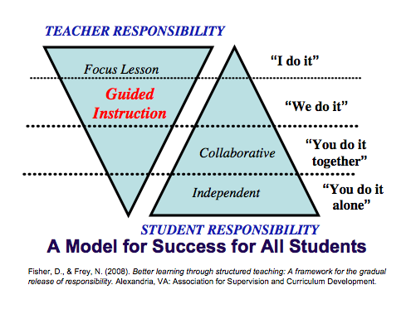
Outcomes
To work collaboratively to deepen our understandings around the GRR
To explore collaboration from the lens of the level you teach
Notes:
7:48 CO-FACILITATOR
8:33 Simply read the outcomes

Slide 6
Agenda
Welcome / Activating Thinking
Develop Deeper Understandings around The Gradual Release of Responsibility - Collaboration
Notes:
7:49 COFACILTATOR
8:34

Slide 7
WORKING AGREEMENTS
Listen with attention
Speak with intention
Take care of the well-being of the group
Maintain confidentiality
Have fun
Notes:
7:50 COFACILTATOR
8:35 Also remind group that a raised hand means to complete your thought, stop and listen for next direction.

Slide 8
Professional Courtesies
Keep cell phones on silent
Check e-mail during breaks
Use laptops to support workshop learning
Notes:
7:51 COFACILTATOR
8:36
Between the working agreements and professional courtesies what might be one that is especially important to you.

Slide 9
Strategy Harvest
Notes:
7:51-7:54 COFACILTATOR
8:36-8:39
Explain - what it is We will be charting strategies, both collaborative and teaching strategies that we are trying with you this morning.
Add first strategy - MIX PAIR FREEZE PAIR SQUARE

Slide 10
Gradual Release of Responsibility of Instruction
Notes:
LEAD FACILITATOR 7:54-8:00 8:39-8:45 restating purpose The goal for this year is to instill a K-12 common vocabulary around the GRR instructional model. - Flashback Reflection- Where are you on your journey in GRR? Recall a moment in your instruction using GRR / Part of GRR - What did you notice? How did it go for your students? Written reflection 3 min, then turn and talk 3 min.

Slide 11
What ways do you currently
use Collaborative Strategies?
Define Collaboration
Basic Group Work
Productive Group Work
Notes:
LEAD FAC> 8:00-8:06 8:45-8:51 pre-printed foldable….explain that it is preprinted to save time. But brain friendly would be to actually create it. A foldable is an ideal way to weave in individual accountability into collaborative work. ADD TO STRATEGY HARVEST: FOLDABLE
Define collaboration and discuss ways and strategies they are currently using in their classrooms 3 min.
Pair / Share what you are currently using 3 min.

Slide 12
Types of Groups
BASIC
Sharing of ideas, beliefs, values and listening to others sharing.
Brief. Goal is sharing.
No accountability
PRODUCTIVE
Consolidating, advocating ideas.
Goal is to resolve, consensus, ID solution
Individual accountability
Notes:
LEAD FAC> 8:06-8:19 and 8:51-9:04
Lecture Burst on Basic Group Work and Productive Group Work (10 minutes at the most)
Fisher/Frey define these groups in two categories: BASIC and PRODUCTIVE
Meaning is constructed both individual and socially. Learners need time to make sense of new information and ideas on their own; they also need time to think aloud and exchange thoughts with others. A number of variables and design choices influence effective student interaction. Basic groups stay together for a short period the goal is the sharing and there is little accountability beyond the expectation of all must participate.
Productice Groups: stay together for a designated period of time and learn to function successfully as a group (3-4-5 students) on structured tasks such as jigsaws, multiple step projects / during marking period or during subject work Here the goal is bigger and usually involves consensus or a solution. Individual accountability tasks are woven into the structure of the group work assigned.
Where does this take your thinking? Turn and Talk 3 MIN.

Slide 13
Patterns of Interaction
Size of the Group
Method for Constructing the Group
Length of Time
Assignment of Roles
Notes:
LEAD FAC> 8:19-8:24 9:04-9:09
5- minutes The teacher also has control of other variables as they create collaborative groups.
Size of the group: Lots of experience with paired activities / moving to larger groups (ie. trios, quartets) shift from quick interactive strategies to projects that require students to remain in group longer
Method for constructing group: teacher created,(most appropriate for guided instruction and collaborative groups) student created (extended projects outside of the classroom) selected randomly (important so that each student has an opportunity to interact-book clubs, discussion groups, idea sharing). Two important variables in determining grouping decisions--how long the interaction and nature of the task. Mixed ability groups purposefully selected by teacher /
Length of Time depends on the purpose of the group
Assignment of Roles: Assigned roles structure and define an individual learner’s responsibilities to the group work. Not every interactive strategy requires the use of roles. It is useful to design and assign roles for each group member when a group has not yet developed the social skills necessary for engaging productively and cooperatively or has little experience with interactive work. Also pays off if the group is together for a long time.

Slide 14
Productive Group Work
Jigsaw your learning: EACH TEACH
Discussion Roundtable pg. 79
Collaborative Poster pgs. 79 to 81
Reciprocal Teaching pgs. 81 to 84
Jigsaw pg.84 to 86
Notes:
COFAC> 8:24-8:35 9:09-9:20 (11 mins. total)
A Jigsaw is a tried and true form of productive group work. It fits all the criteria: individuals are accountable for consolidating ideas
Read your section silently and highlight 3 mins./ take notes on key ideas to share with your group
Each Teach your reading / understanding 2 minutes each / total of 8 minutes ADD TO STRATEGY HARVEST: JIGSAW

Slide 15
Connections
Types of Groups
Patterns of Interaction
Basic Group Work
Productive Group Work
Size of the Group
Method for Constructing the Group
Length of Time
Assignment of Roles
Notes:
CO FAC> 8:35-8:40 9:20-9:25
What Connections are you making to this thinking? TABLE CONVERSATION 5 minutes
ADD TO STRATEGY HARVEST: TABLE CONVERSATION

Slide 16
How Proficient Collaborators Think and Act
Kids are not born knowing how to work effectively in small groups; we have to show them explicitly.
Notes:
LEAD FAC >8:41 9:26 So we want our students to be eager to work with each other successfully. We want to trust kids to stay on task when we put them in small groups. Collaborative, interdependent, high-morale groups are mostly made, not born. However most teachers struggle a touch with getting their minds around how that looks and sounds.
Participants look at How Proficient Collaborators Think and Act Handout / As you peruse the handout……..

Slide 17
How Proficient Collaborators Think and Act
Which of these strategies do you use? do your students use?
Which of these strategies might need to be modeled and practiced to encourage students/adults to use?
Notes:
LEAD FAC> 8:41-8:56 9:26-9:31 First I am going to give you time to talk with a partner….WHY? because there is increased chance for conversation on both sides to stimulate thinking, then after 5 mins or so, I am going to ask you to turn to your table and talk to increase the number of ideas/questions that can be generated from several peoples’ thinking. ADD TO STRATEGY HARVEST: PARTNER TALK TO TABLE TALK
Partners talk using chart of How Proficient Collaborators Think and Act / as a visual.
Share with table group / What are you learning around collaboration? What questions do you have?
Share out some thinking with large group.

Slide 18
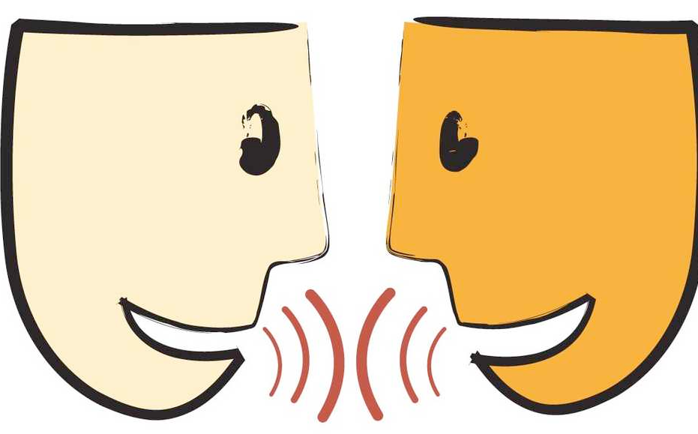
Paired Verbal Fluency
Letter off A – B
Take turns talking about topic
Do not repeat anything already said
Three rounds
Notes:
CO FAC> 8:56-9:01 9:31-9:36 5MIN. (3 rounds, each about 60-90 seconds)
Paired Verbal Fluency is a basic collaborative practice that boarders on a productive group practice depending on how it is used. It can be a great stimulator of ideas, but also a great way to measure what is remembered from previous teaching. In this case we are going to use it to solidify some new learning and ideas. (Then explain slide.) ADD TO STRATEGY HARVEST: PAIRED VERBAL FLUENCY

Slide 19
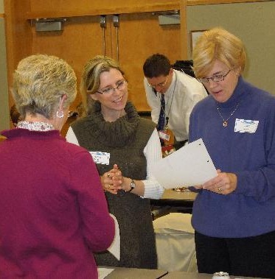
Paired Verbal Fluency
Talk about all that you NOW know around “Collaboration”.

Slide 20
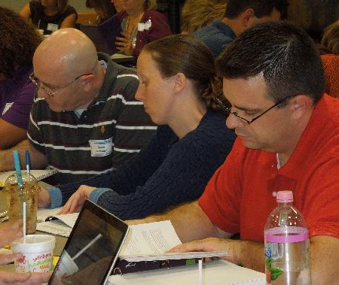
Back to your Foldable
Where is your thinking now around “Collaboration”?
Notes:
LEAD FAC > 9:01 to 9:11 9:36-9:46
Reflection: Where is your thinking now around “ Collaboration”?
Reflect on foldable in diamond or on the back. ( As an aside, explain again that here is a sample of the individual accountability factor from the foldable activity)
If time - questions you still have around collaboration
ADD ABOUT ARTICLE

