Slide 1
Indirect Statement
The teacher asks that you pay attention.

Slide 2
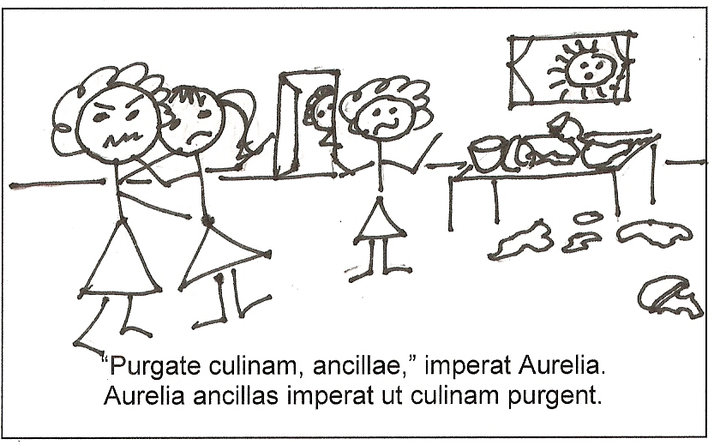

Slide 3
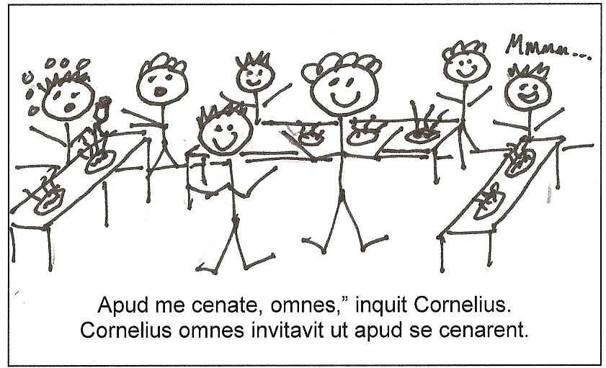

Slide 4
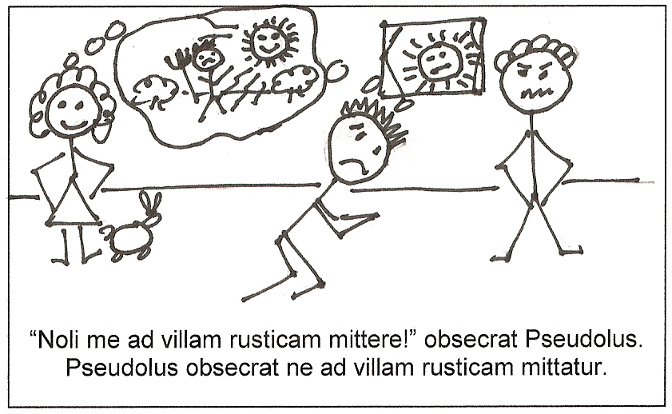

Slide 5
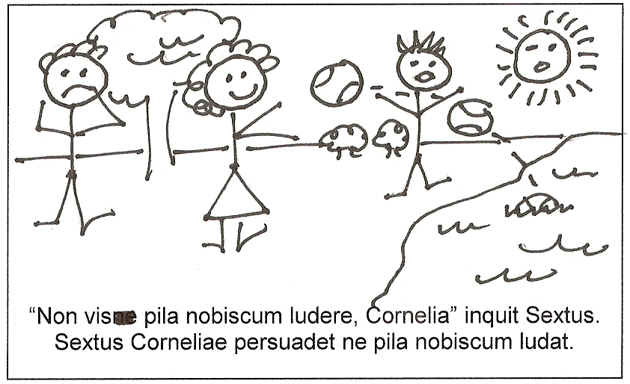

Slide 6
Until now we have had just one way of giving orders in Latin, using the verb iubeo, iubere.
Aurelia ancillas purgare culinam iussit. Aurelia ordered the slave women to clean the kitchen.
Iubere is the only verb that uses an accusative and infinitive to show command. All other verbs of commanding, ordering, beseeching, advising, etc. use another construction.

Slide 7
Aurelia ancillas imperat
ut culinam purgent.
What are the elements of an Indirect Command?
Start with a verb of commanding, asking, warning, etc.
Introduce the command with ut (yes, again)
Use a subjunctive that shows incomplete action (pres, imperf)
Cornelius omnes invitavit ut apud se cenarent.

Slide 8
Indirect Commands
Indirect Commands
Try some simple indirect commands on your own. Watch your tenses! Use your vocabulary sheets for help with these verbs.
Cornelius convivas invitat ut in atrium procedant.
Te oro atque obsecro ut domum venias.
Davus pueros monuit ut abirent.
Parentes nos rogaverunt ut in tablinum ingrederemur.
Quintus Valerius hortatur ut Cornelia sibi despondeatur.
Cornelius praecepit ut vinum adferretur.

Slide 9
Sextus Corneliae persuadet ne pila nobiscum ludat.
What changes are necessary for a negative Indirect Command?
Introduce the command with ne instead of ut.
Pseudolus obsecrat
ne ad villam rusticam
mittatur

Slide 10
Indirect Commands
Try these simple negative indirect commands. Watch your tenses! Use your vocabulary sheets for help with these verbs of ordering and asking.
Grammaticus Sextum monebit ne obdormiat.
Cornelius pueris praecepit ne soli foras egrederentur.
Aurelia Corneliam hortata est ne laborem neglegeret.
Cornelia orat ne sola domi sedeat.
Sextus obsecrat ne domi reliquatur.
Ignavus servus rogabat ne ad villam rusticam dimitteretur.

Slide 11
Indirect Commands
Report, do not quote, a command or request—usually an imperative.
Introduced by ne or ut.
Use an incomplete (present or imperfect) subjunctive.
Look for them to be introduced with verbs of asking, commanding, begging, inviting, urging, ordering, asking, and the like. Know well the verbs on your vocabulary sheet.

Slide 12
Indirect Commands
What was the original English and Latin command for each of these indirect commands?
Te oro atque obsecro ut domum venias.
Come home! Domum veni!
2. Cornelius convivas invitat ut in atrium procedant.
Proceed into the atrium! In atrium procedite, convivae!
3. Parentes eos rogaverunt ut in tablinum ingrederentur.
Enter the study! In tablinum ingredemini!
4. Sextus obsecrat ne domi reliquatur.
Don’t leave me behind! Noli / Nolite me domi reliquere!
5. Cornelius pueris praecepit ne soli foras egrederentur.
Don’t go outside alone! Nolite soli foras egredi, pueri!

Slide 13
Indirect Commands
Take these Latin sentences and finish turning them into indirect commands. Watch your tenses!
“Volo Flaviam Romam venire,” inquit Cornelia.
Cornelia Flaviam hortatur
“Multas epistulas scribe,” Flavia Corneliam obsecravit.
Flavia Corneliam obsecravit
“Noli me sequi ad Forum, mi fili,” praecipit Cornelius.
Cornelius mihi praecipit
Princeps nos monebat, “Nolite huc regredi.”
Princeps nos monebat
“Visne ad urbem ire?” inquit amica mea.
Amica mihi persuasit
ut Romam veniat.
ut multas epistulas scriberet.
ne se ad Forum sequar.
ne huc regrederemur.
ut ad urbem irem.

