Slide 1
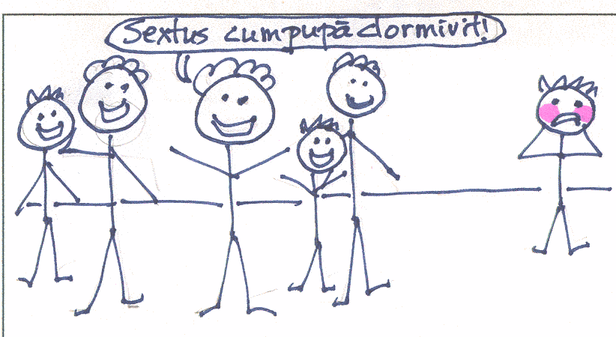
How does the sentence change when the infinitive changes?
Marcus dicit Sextum cum pupā dormire.
Marcus says that Sextus is sleeping with a doll.
Marcus dicit Sextum cum pupā dormivisse.
Marcus says that Sextus had slept with a doll.

Slide 2
How does the sentence change when the infinitive changes?
Marcus videt Sextum cum pupā dormire.
Marcus sees that Sextus is sleeping with a doll.
Marcus videt Sextum cum pupā dormivisse.
Marcus sees that Sextus had slept with a doll.
Cornelius dicit raedarium raedam e fossā non extrahere.
Cornelius says that the driver isn’t pulling the carriage out of the ditch.
Cornelius dicit raedarium raedam e fossā non extraxisse.
Cornelius says that the driver hasn’t pulled the carriage out of the ditch.

Slide 3
The perfect active infinitive is used to report something that has previously happened.
Eucleides dicit grammaticum misisse Sextum domum.
Eucleides says that the teacher has sent Sextus home.
The present infinitive is used to report something that is currently happening.
Davus putat Sextum esse molestissimum.
Davus thinks that Sextus is very annoying.
Marcus videt Sextum cum pupā dormire.
Marcus sees that Sextus is sleeping with a doll.

Slide 4
The perfect active infinitive is used to report something that has previously happened.
The present infinitive is used to report something that is currently happening.
Marcus Corneliae dicit Sextum cum pupā dormire.
Marcus says to Cornelia that Sextus is sleeping with a doll.
Can you recognize how to report something that will happen in the future?
Marcus Eucleidi dicit Sextum cum pupā dormiturum esse.
Marcus says to Eucleides that Sextus is going to sleep with a doll.
Marcus aliis discipulis dicit Sextum cum pupā dormivisse.
Marcus says to the other students that Sextus (has) slept with a doll.

Slide 5
Can you translate these sentences with indirect statements?
Watch the tense of the infinitive.
Eucleides dicit praedones suam pecuniam eripuisse.
  Euclides says the robbers snatched away his money.
Sextus scribit grammaticum discipulos verberare.
  Sextus writes that the teacher beats the students
Cornelia credit Quintum Valerium esse pulchrum.
  Cornelia believes that Quintus Valerius is handsome/pretty.
Convivae vident Titum plurimum vinum bibisse.
  The guests see that Titus drank the most wine
Aurelia dicit se optimos glires edisse.
  Aurelia says she ate the best dormice.
Cornelius putat Titum sero advenisse.
  Cornelius thinks that Titus arrived late.
Cornelius putat Titum sero advenire.

Slide 6

Future Infinitive
Future Participle + esse / dormiturus esse
Used to show action after the main verb in indirect statement. The participle agrees with the accusative subject.
Eucleides sperat praedones se non secuturos esse.
Cornelia putat patrem Sextum verberaturum esse.
Titus sperat Cornelium cenam daturum esse.
Sextus videt furem vestimenta surrepturum esse.
Eucleides putat se moriturum esse.
Sextus dicit se calorem non passurum esse.
Adulescens sperat se diu victurum esse; senex potest dicere se diu vixisse. Cicero

Slide 7
Future Infinitive
In indirect statement, the participle of the future infinitive must agree with the accusative subject.
Eucleides sperat praedones se non secuturos esse.
Eucleides putat se pueros latrunculis docturum esse.
Cornelia dicit se facturam esse pupam filiae Davi.
Eucleides timet se moriturum esse.
Davus videt Corneliam et Flaviam sub arbore lecturas esse.
Caupo cognoscit Cornelios in cauponā pernoctaturos esse.
Sextus putat se calorem in caldario non passurum esse.

Slide 8
Indirect Statement
Use of the present infinitive shows action going on at the same time as main verb
Use of the perfect infinitive shows action that went on before the main verb
Use of the future infinitive shows action that will happen after the main verb
Use of the reflexive pronoun refers to the subject of the main verb.

Slide 9
Can you translate these indirect statements with a present passive infinitive? When does the infinitive action take place in relation to the main verb?
Eucleides sperat Sextum domum remitti.
Cornelia putat Sextum a patre verberari.
Titus sperat cenam a fratre dari.
Sextus videt vestimenta surripi.
Eucleides putat se mori.
Titus amicique non intellegunt nimis vini bibi.

Slide 10
Can you translate these sentences using passive infinitives?
Amici dicunt vinum optimum a Tito semper emi.
Amici dicunt vinum optimum a Tito semper emptum esse.
Amici dicunt cenam optimam a Cornelio dari.
Amici dicunt cenam optimam a Cornelio datam esse.
Legimus parentes inter se rixari.
Legimus parentes inter se rixatos esse.
Eucleides putat praedones se sequi.
Eucleides putat praedones se secutos esse.
Eucleides putat praedones se secuturos esse.

